Slide 1

ScanMasterX Team No 10: UwUltimate Stardust Crusaders

Slide 2





Team Details
Eric
Lewis
Dennis
Alexa
Will

Slide 3
Project Overview
Problem: The Rising Cost of Cybersecurity Breaches
Average Data Breach Cost: $4.45 million (Forbes)
Projected Cybercrime Damages: Over $10 Trillion by 2025 (Forbes)
Our Solution: ScanMasterX
Our Vision:
Lower the barrier to scan and analyze complex networks
Prevent Data Breaches by accessing vulnerable services
Perform Security testing
Display the Topology and Rating

Slide 4
Requirements List
There must be a feature to identify vulnerabilities on a server.
There must be a component that will evaluate the security of the ports on a given server.
The user must be able to select which device(s), which ports, or which group of ports, that they wish to test and scan.

Slide 5

Project Solution Approach
Major Components
Custom scanner leveraging Nmap
GUI for user to interact with
Tools, Frameworks, Platforms, Libraries
PYQT - UI framework for Python
NMAP – A CLI network scanner
CVE Database [TBD]

Slide 6
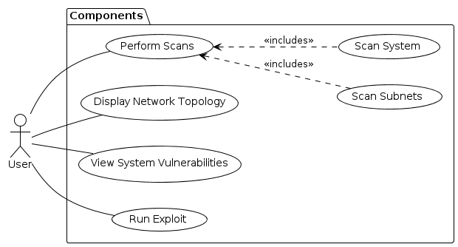
Use Case Modeling

Slide 7
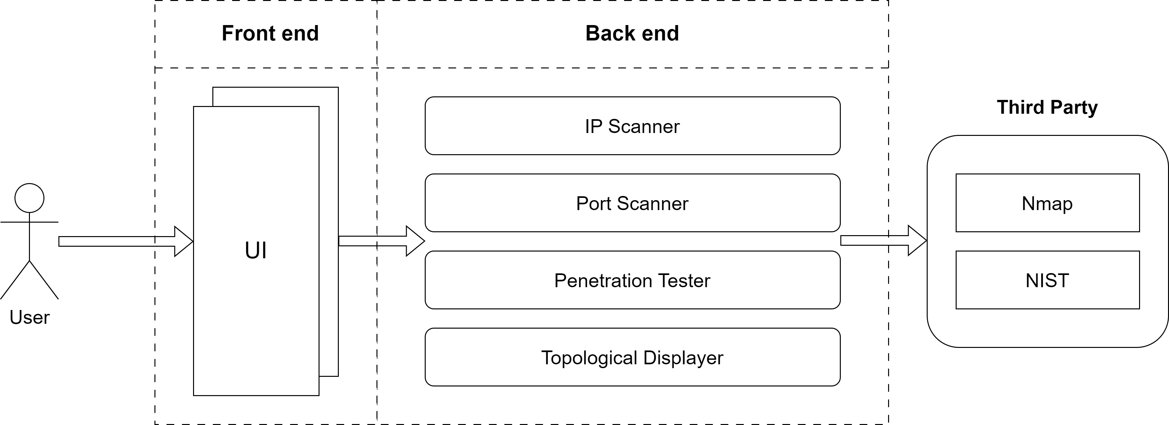
System Architecture Diagram

Slide 8
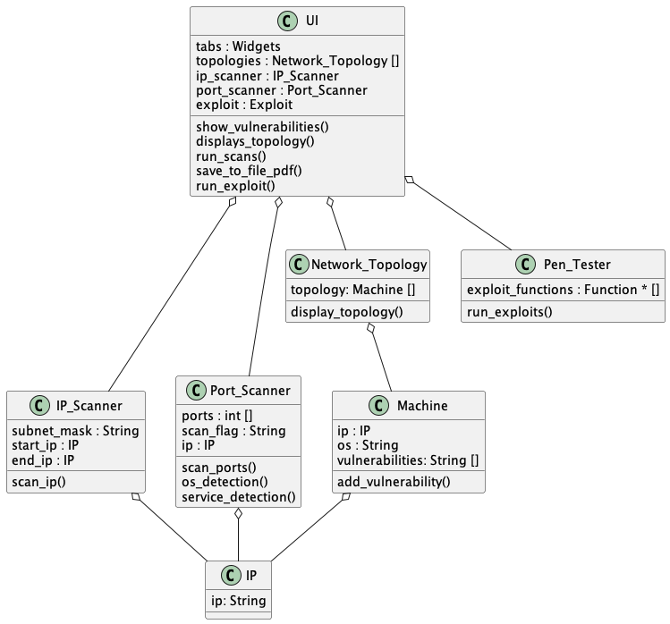
Structural Modeling: Class Diagram

Slide 9
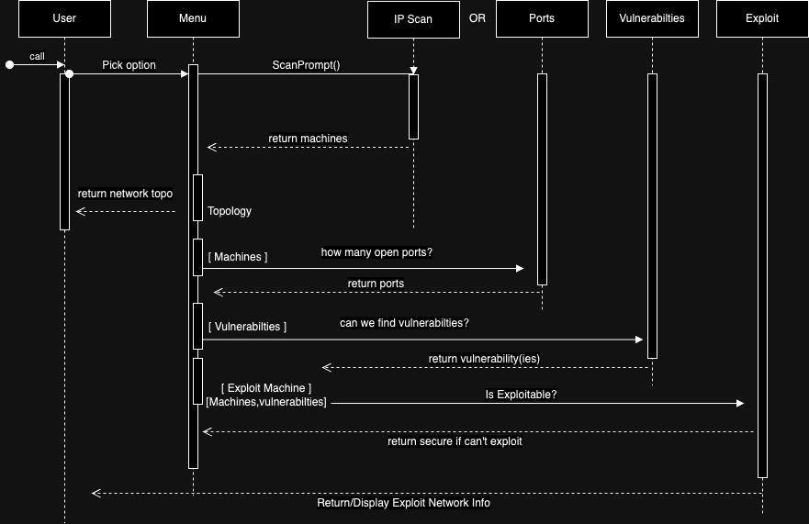
Behavioral Modeling: Sequence Diagram

Slide 10
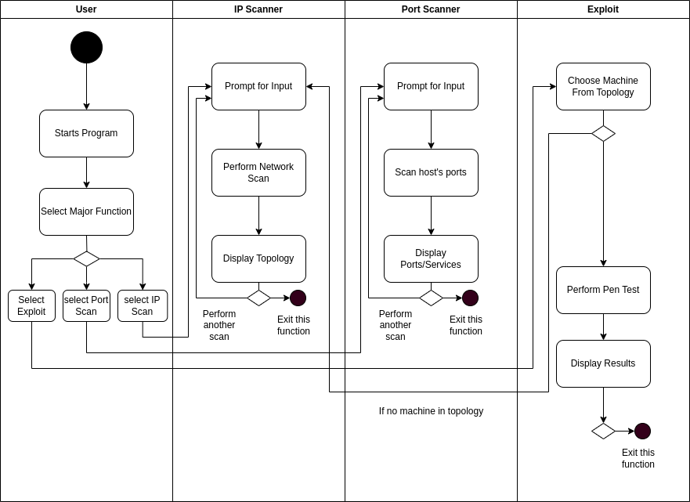
Behavioral Modeling: Activity Diagram

Slide 11
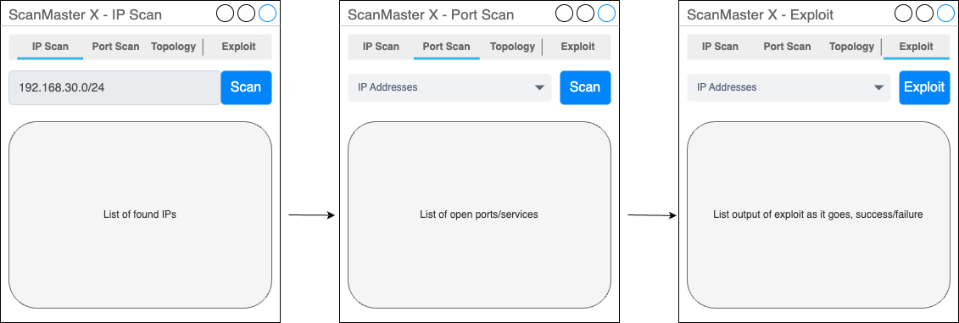
Screenshots (UI, Code, if any)

Slide 12
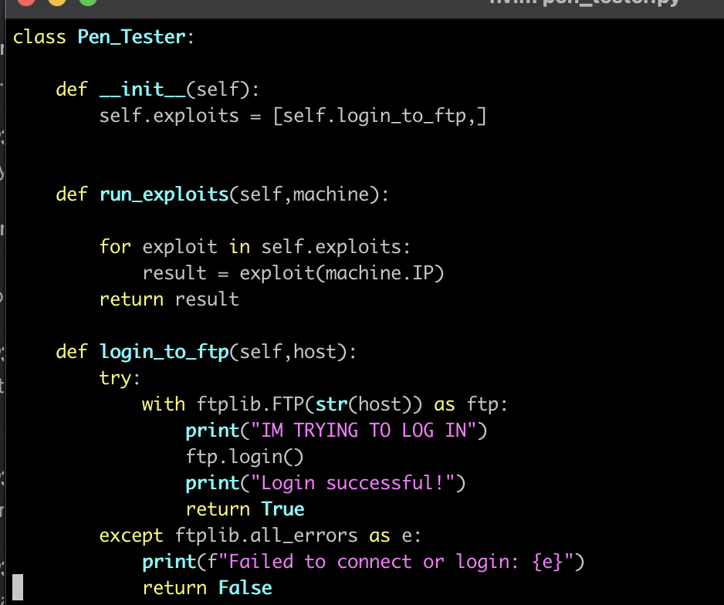
Demo Time on Exploits!

Slide 13

What’s Next??
Development of the UI
Displaying the Topology
Identifying Vulnerabilities

